Slide 1

Chennai Estate’s Price Prediction Model
Team Nirvana :
Soumyadeep Chowdhury
Subhranil Roy
Praxis Business School

Slide 2
Business Case
Mr Satyanarayanan is a young and dynamic engineer, working in one of the top IT MNC in Chennai.
He’s planning to start his family soon so he decides to buy a new house in Chennai and comes to know about ‘ChennaiEstate’ – a real estate ‘Aggregator’ website
He then checks the website of ‘ChennaiEstate’ and learn more about the real estate properties and it’s price
We, the ChennaiEstate Analytics team, have deployed a ‘Price Prediction model’ for helping our customers
Mr Satyanarayanan enters various features of the property he wants to buy and clicks the ‘Predict’ button
Our model shows him the Price of the property along with visualizations

Slide 3
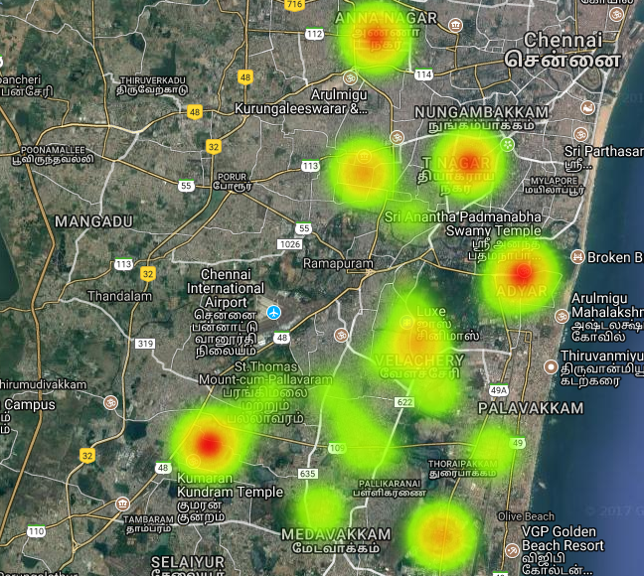
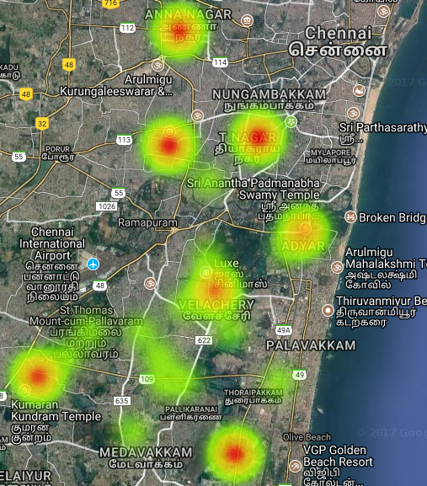
Consumer Decision Dilemma
Price per Square feet heat map [Dark Red: High Price , Dark Yellow: Low Price]
Commission per Square feet heat map [Dark Red: High Commission, Dark Yellow: Low Commission]

Slide 4
Our Approach
Exploratory Data Analysis – Checking of Missing values and other irregular values in the train & test dataset.
Visualisation – various kinds of plots, e.g.- density plot, bar plot, heat map, contour plots, bubble charts etc.
Missing value imputation
Feature Engineering
Model building
Model validation

Slide 5
Exploratory Data Analysis
First we checked for Missing values/Blank values/other irregular values
We found missing values for the columns – Bedroom, Bathroom and Overall score in train and test set
We used the ‘missForest’ package to replace the missing values in both train and test set.
This package uses tree-based Random Forest to replace the categorical values and Random Forest Regression to replace the numerical values
Then we used ‘RLOF’ package to detect multivariate outlier. We found a very few outliers (and removed them for linear regression model)

Slide 6
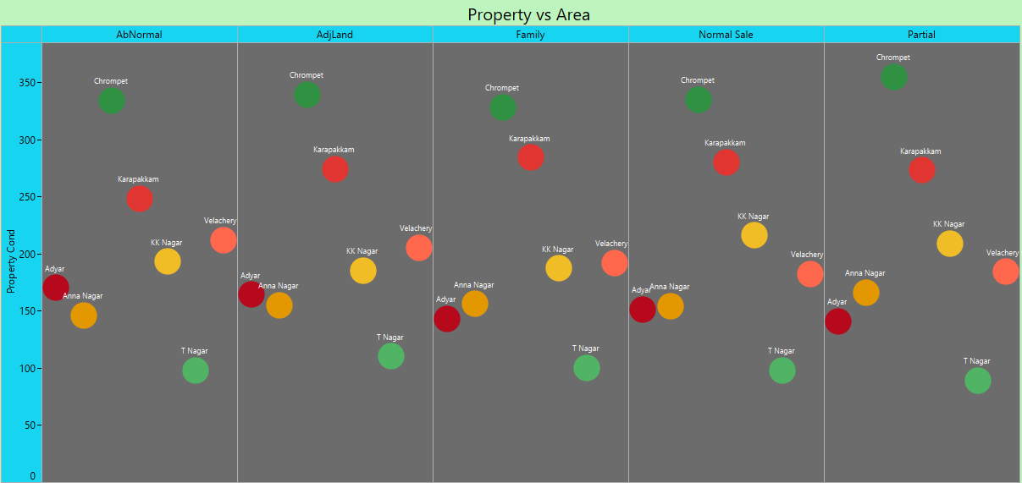
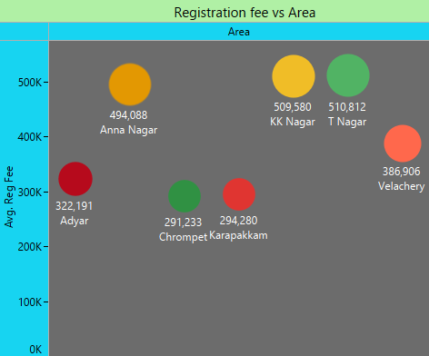
Advanced Visualisations – Bubble Charts
This chart shows the conditions of the properties being sold in various Locations with different colour bubbles
This chart shows average Property Registration Fee in various Locations with different colour bubbles

Slide 7
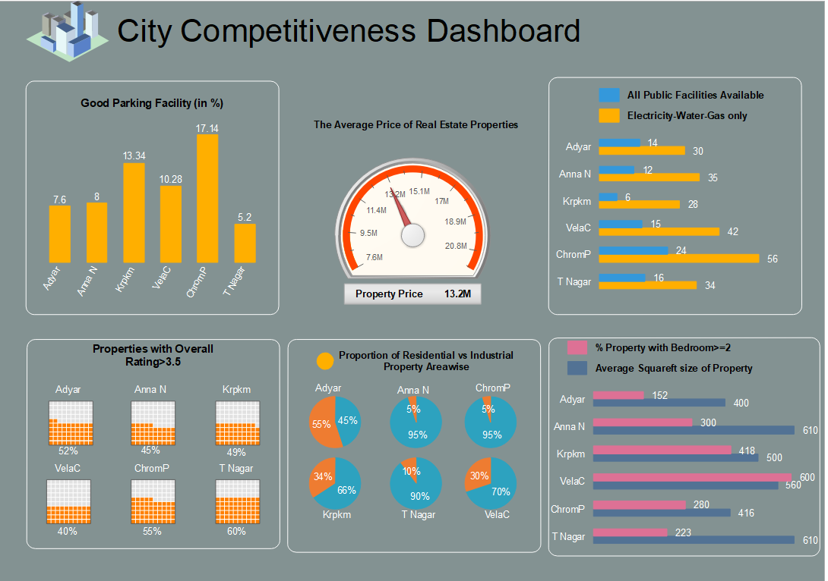

Slide 8
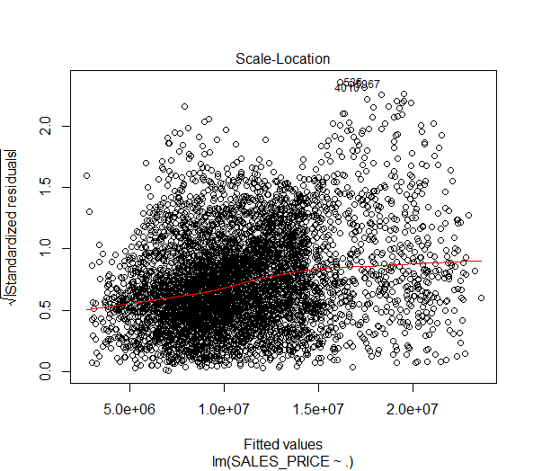
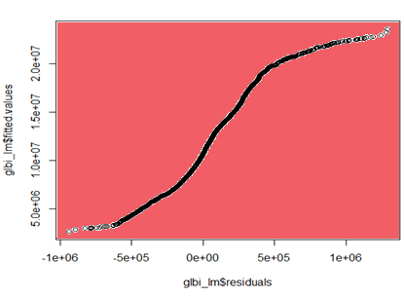
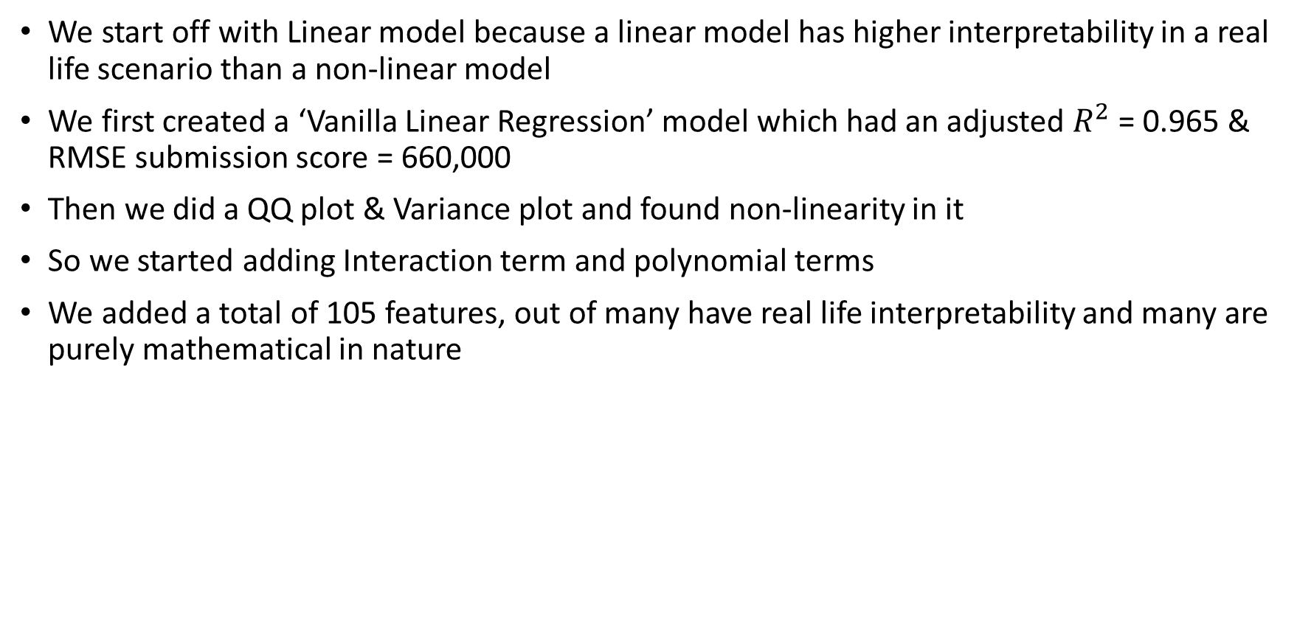
Feature Engineering & Model Building
We start off with Linear model because a linear model has higher interpretability in a real life scenario than a non-linear model
We first created a ‘Vanilla Linear Regression’ model which had an adjusted $R^{2}$ = 0.965 & RMSE submission score = 660,000
Then we did a QQ plot & Variance plot and found non-linearity in it
So we started adding Interaction term and polynomial terms
We added a total of 105 features, out of many have real life interpretability and many are purely mathematical in nature

Slide 9
Non-Linear model – Deep Learning
The RMSE achieved after adding 105 features = 225,000 and we hit a plateau after that point
At this point the QQ plot still showed presence of high non-linearity at some portions
So we decided to try non-linear model – Artificial Neural Network
We have used the H2o package in R to model the data with Single Layer Neural Network and Deep Neural Network
H2o package divides the core into 4 parts and distributes the computation so it is considerably fast compared to other DL packages available in R
We have used ‘ReLU’ as the activation function as it performs better compared to ‘Tanh’ activation in Multiple hidden layer architecture
First we tried to tune single hidden layer but later moved on to double hidden layer to obtain improved RMSE score

Slide 10

Deep Learning Architecture & Tuning
RMSE: 150000
We started of with a single hidden layer model with 20 hidden nodes and we got an RMSE around 150,000. Then we used the ‘Random Discrete Search’ feature to find the optimal 2 hidden layer architecture
The 2 layer architecture came out to be – (20,25) with RMSE around 100,000
The ‘Random Discrete Search’ does not always give the optimal parameters. So we tried many more 2 layer architectures – (25,30) with RMSE around 50000
(30,35) with RMSE around 20000
And finally, it plateaued at (32,39) with RMSE around 9642
RMSE: 100000
RMSE: 50000
RMSE: 20000
RMSE: 9600

Slide 11
Benefit Analysis – Business & Consumer
This model will benefit ‘Chennaiestate’ in various ways –
Increase transparency between ‘chennaiestate’ & it’s customers
Enable customers with no/minimal knowledge to understand about the actual price
Help chennaiestate to establish a trust relationship with it’s customers
Increase customer satisfaction
Positive word of mouth due to increased ‘CSAT’ and consequently higher market share
Customers will be benefited in following ways –
A transparent system to know about the actual real estate prices
An unbiased automated system for price prediction without human influence
Compare with the various real estate builder prices and decide from whom to buy
Fast, convenient and flexible system for price understanding

Slide 12
THANK YOU

